Slide 1
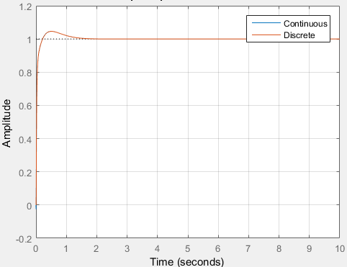
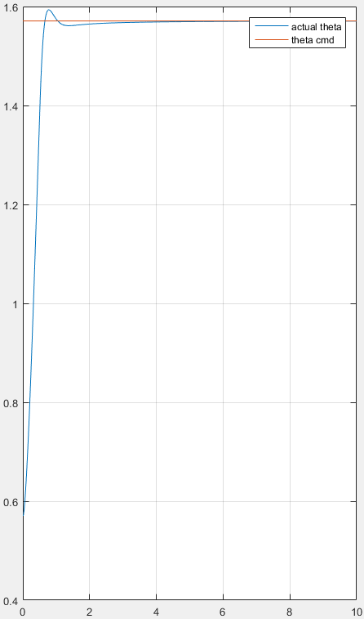
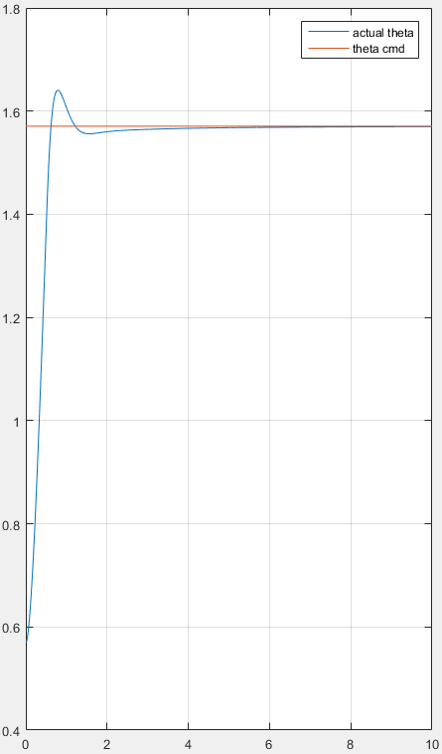
Comparison
Pitch
Time response in design phase
Time response in simulator (loopshaping)
Time response in simulator (PID)
Rise time: 0.0702
Overshoot: 5%
Rise time: 0.428
Overshoot: 2.2%
Rise time: 0.412
Overshoot: 6.9%

Slide 2

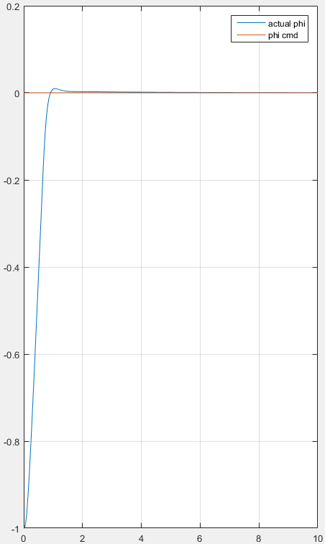
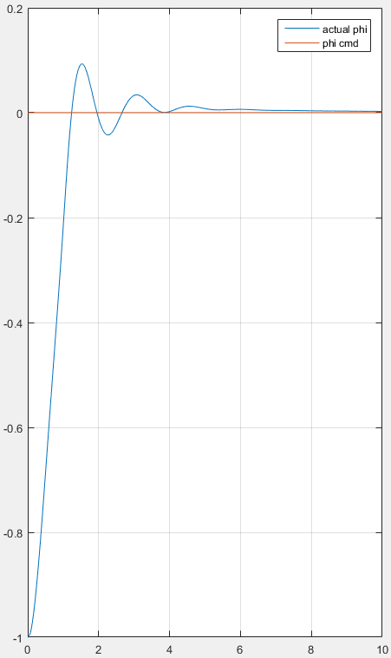
Comparison
Roll
Time response in design phase
Time response in simulator (loopshaping)
Time response in simulator (PID)
Rise time: 0.068
Overshoot: 1%
Rise time: 0.552
Overshoot: 1%
Rise time: 0.864
Overshoot: 9.3%

Slide 3
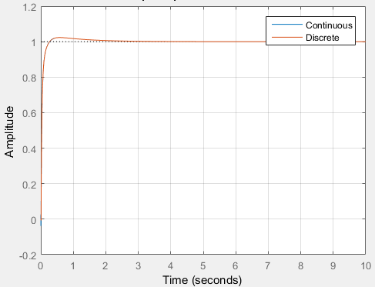
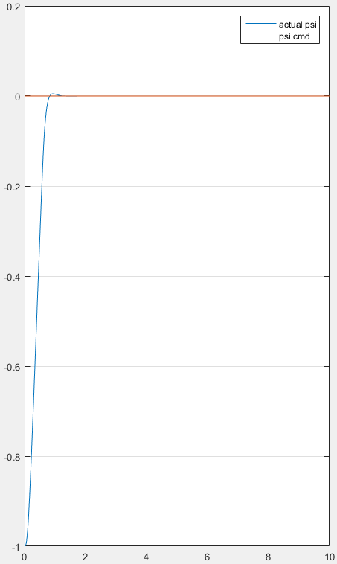
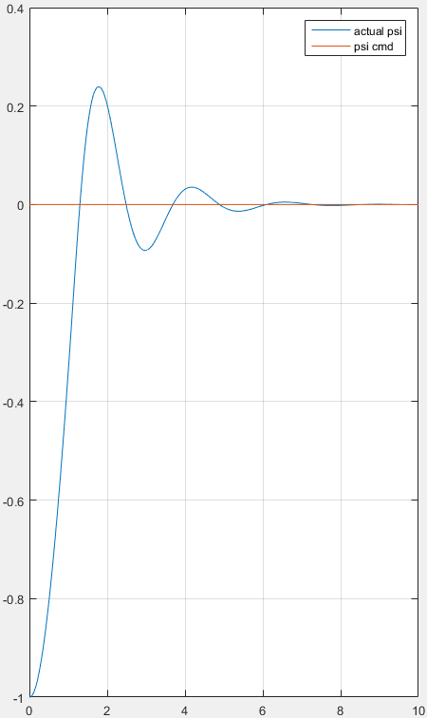
Comparison
Yaw
Time response in design phase
Time response in simulator (loopshaping)
Time response in simulator (PID)
Rise time: 0.0928
Overshoot: 2%
Rise time: 0.48
Overshoot: 0.5%
Rise time: 0.852
Overshoot: 24%

